Slide 1
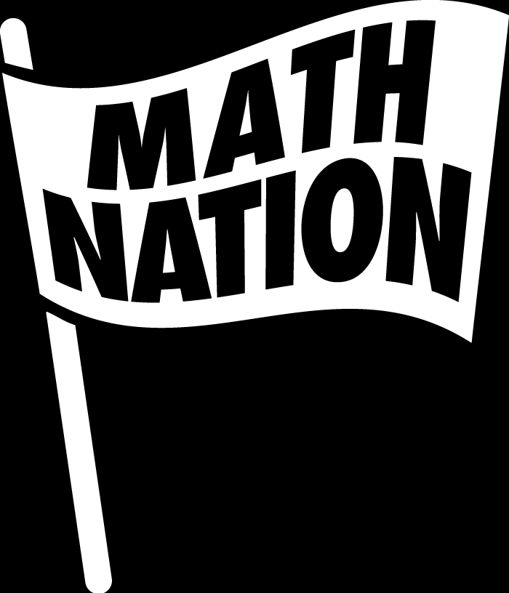
6th Grade Accelerated Math Unit 9, Lesson 3 Finding and Interpreting the Mean, Median, Mode, and Range Volume 2, pg. 50

Slide 2


Benchmark
MA.6.DP.1.2
Given a numerical data set within a real-world context, find and interpret mean, median, mode, and range.
volume 2, pg. 50

Slide 3
Integrated Mathematical Thinking and Reasoning Standards
MA.K12.MTR.4.1 Engage in discussions that reflect on the mathematical thinking of self and others.
MA.K12.MTR.7.1 Apply mathematics to real-world contexts.
volume 2, pg. 50

Slide 4

Learning Targets
I can find the mean, median, mode, and range of a given data set.
I can interpret the mean, median, mode, and range of a given data set.
volume 2, pg. 50

Slide 5

Warm-Up
volume 2, pg. 50

Slide 6
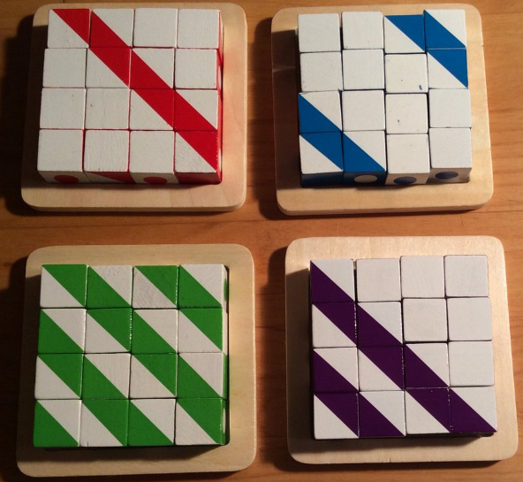
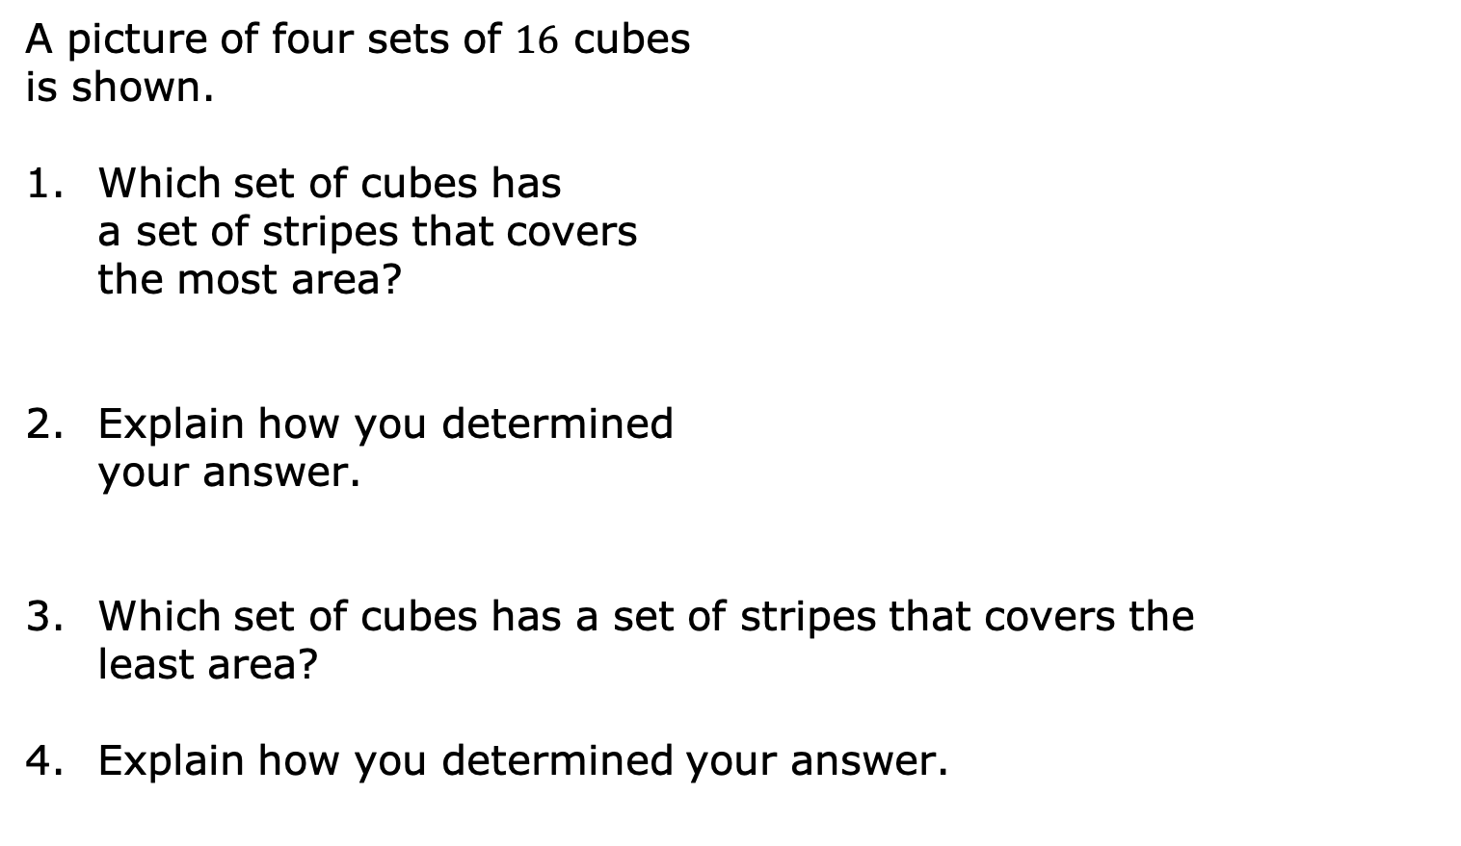
9.3.1 Warm-Up: Stripes
A picture of four sets of $16$ cubes is shown.
Which set of cubes has a set of stripes that covers the most area?
Explain how you determined your answer.
Which set of cubes has a set of stripes that covers the least area?
Explain how you determined your answer.
volume 2, pg. 50

Slide 7

Exploration
volume 2, pg. 51

Slide 8

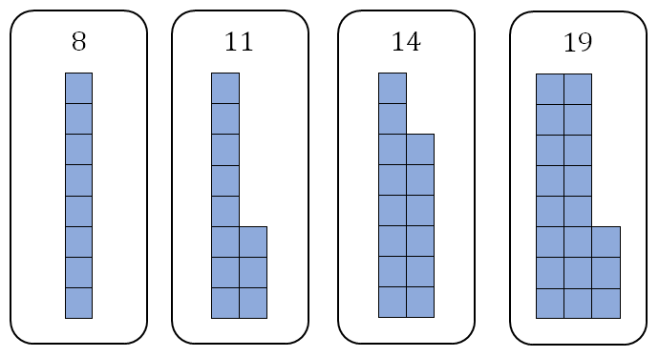
9.3.2 Exploration: Sharing Squares
Estimate the number of squares that will be in each group if they were distributed evenly between the four groups.
volume 2, pg. 51

Slide 9
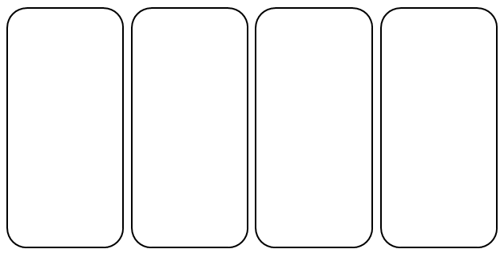
Use the diagram to redistribute the squares so that each of the four groups has the same number of squares.
Compare diagrams with your partner. Discuss how you each determined the number of squares that belong in each group. Summarize your discussion.
volume 2, pg. 51

Slide 10

Collaboration
volume 2, pg. 51

Slide 11


9.3.3 Collaboration: Mean of Data
By redistributing the squares in the diagram, the mean of the data set was found.
Data in a numerical set is summarized using different measures that are interpreted to describe the data. One such measure used to describe quantitative data sets is the mean.
To calculate the mean, add all the values in the data set and then divide by the total number of data values.
The mean is the arithmetic average of a set of numbers. It is a measure of central tendency.
volume 2, pg. 51

Slide 12
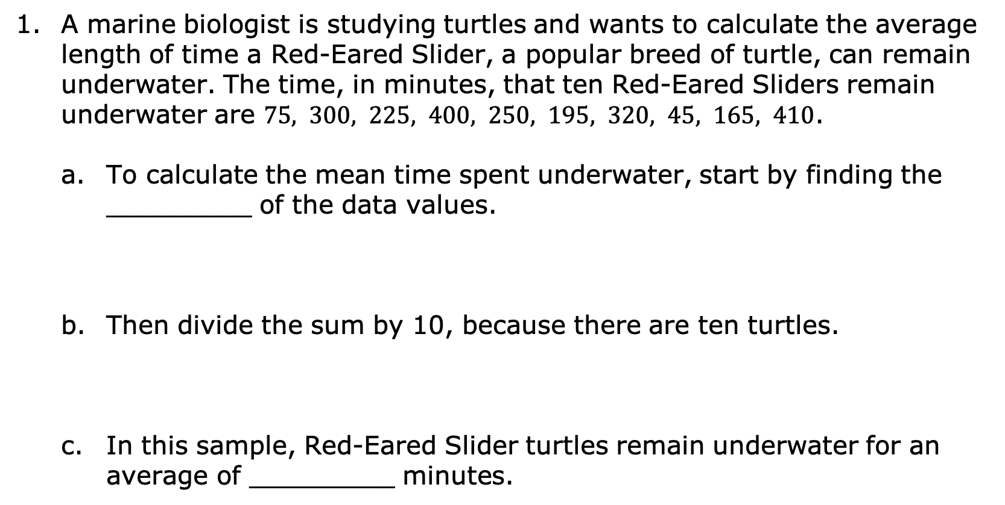
A marine biologist is studying turtles and wants to calculate the average length of time a Red-Eared Slider, a popular breed of turtle, can remain underwater. The time, in minutes, that ten Red-Eared Sliders remain underwater are $75, 300, 225, 400, 250, 195, 320, 45, 165, 410$.
To calculate the mean time spent underwater, start by finding the _________ of the data values.
Then divide the sum by 10, because there are ten turtles.
In this sample, Red-Eared Slider turtles remain underwater for an average of _________ minutes.
volume 2, pg. 51

Slide 13

Measures of center are numerical values used to describe the overall clustering of data in a set, or the overall central value of a set of data. The three most common measures of central tendency are the mean, median, and mode.
volume 2, pg. 52

Slide 14

Guided Instruction
volume 2, pg. 52

Slide 15
9.3.4 Guided Instruction: Mean, Median and Mode
For each definition, fill in the blank with one of the words from the bank.
median | mode
mean | range
The ___________ is the arithmetic average of a set of numbers. It is a measure of central tendency.
The ___________ is the difference between the highest data value and the lowest data value in a data set. It is a measure of variation.
volume 2, pg. 52

Slide 16
median | mode
mean | range
The ___________ is the value found most often in a set of numbers. There may be no, one, or more than one __________ in the data set. It is a measure of central tendency.
The ___________ is the middle of an ordered list of the values. If the list has an odd number of values, it is the middle value of that list. If the list has an even number of values, it is the average of the two middle values. It is a measure of central tendency.
volume 2, pg. 52

Slide 17
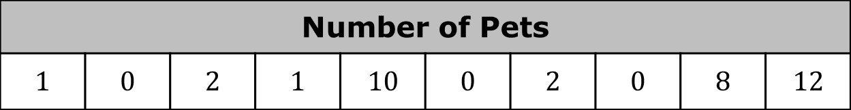
The number of pets ten students in Tyler’s class have is reflected in the table.
Describe steps to find the median.
The median number of pets for the ten students is _________.
Number of Pets
$$1$$ | $$0$$ | $$2$$ | $$1$$ | $$10$$ | $$0$$ | $$2$$ | $$0$$ | $$8$$ | $$12$$
volume 2, pg. 53

Slide 18
The mode of the data set is ____________.
Write an explanation of what the mode of the data set means for the context.
volume 2, pg. 53

Slide 19
Describe the steps needed to find the average number of pets owned by the ten students.
The mean number of pets for the ten students is __________.
Complete the statement about the mean of the data set. “Each student in Tyler’s class has about _________ pets.”
volume 2, pg. 53

Slide 20

Try It
volume 2, pg. 54

Slide 21

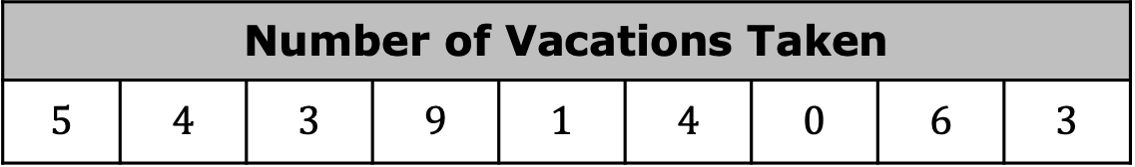
9.3.5 Try It: Mean, Median, and Mode
Nine adults boarding a cruise ship at Port Canaveral in Florida were randomly surveyed on the total number of vacations they have taken in the last five years. Their totals are summarized below.
What does the value of the median represent in the context?
What is the median number of vacations taken by the adults surveyed?
Number of Vacations Taken
$$5$$ | $$4$$ | $$3$$ | $$9$$ | $$1$$ | $$4$$ | $$0$$ | $$6$$ | $$3$$
volume 2, pg. 54

Slide 22
Determine the mean of the data. Then, interpret the mean in terms of the context by writing a sentence to summarize. Round to the hundredths.
volume 2, pg. 54

Slide 23
Exploration
volume 2, pg. 54

Slide 24
9.3.6 Exploration: Understanding Mode and Range
Work with your partner to complete the following.
The is the value occurring most often in a set of data, which can be used to describe trends in data.
mean
median
mode
range
volume 2, pg. 54

Slide 25
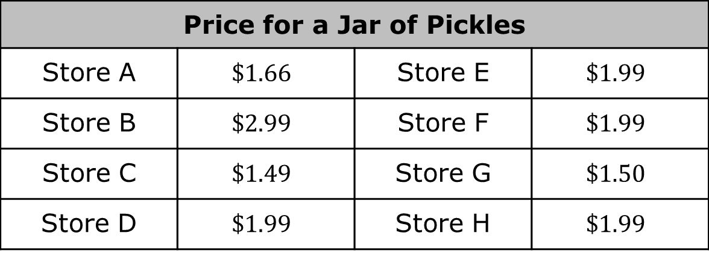
While shopping over the last month, Shep collected the price for a jar of pickles from eight stores he visited.
What does a jar of pickles cost at most stores?
This value is the
What is the most Shep will spend on a jar of pickles?
Price for a Jar of Pickles
Store A | $$\$1.66$$ | Store E | $$\$1.99$$
Store B | $$\$2.99$$ | Store F | $$\$1.99$$
Store C | $$\$1.49$$ | Store G | $$\$1.50$$
Store D | $$\$1.99$$ | Store H | $$\$1.99$$
median of the data set.
mode of the data set.
volume 2, pg. 54

Slide 26
What is the least Shep will spend on a jar of pickles?
The range of a data set describes how spread out the data is. Determine the range in price for a jar of pickles.
volume 2, pg. 55

Slide 27
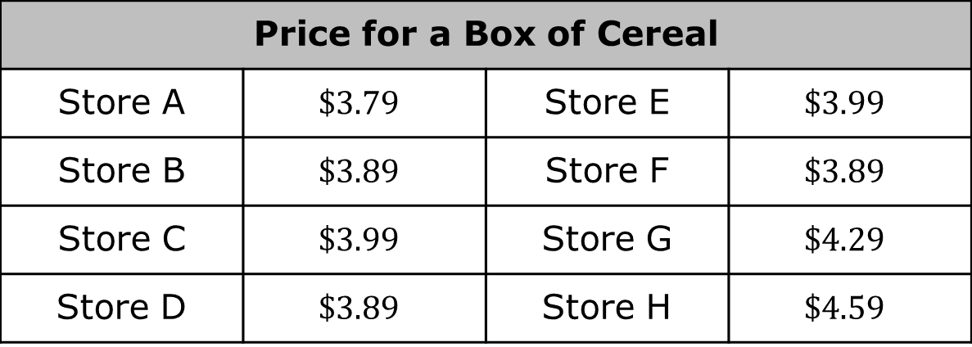
Shep also began collecting the price of his favorite cereal to determine where he would get the best price.
The mode price of his favorite box of cereal is _____________.
What is the most Shep will spend on a box of cereal?
Price for a Box of Cereal
Store A | $$\$3.79$$ | Store E | $$\$3.99$$
Store B | $$\$3.89$$ | Store F | $$\$3.89$$
Store C | $$\$3.99$$ | Store G | $$\$4.29$$
Store D | $$\$3.89$$ | Store H | $$\$4.59$$
volume 2, pg. 55

Slide 28
What is the least Shep will spend on a box of cereal?
The range for the price of a box of cereal is ______________.
The range describes the of the data set.
center
variability
volume 2, pg. 55

Slide 29

With your partner, discuss whether the price for pickles or the price for cereal has more variability in pricing. Summarize the discussion.
Measures of variability are numerical values that measure how much a data set varies from a central value.
The range is a measure of variability. By comparing the ranges for two or more data sets, the data set that has more variability can be determined by finding which has a larger ___________.
volume 2, pg. 55

Slide 30

Wrap-Up
volume 2, pg. 56

Slide 31
9.3.7 Wrap-Up: Reflection
Read each of the “I can” statements below. Check the boxes that best explain your understanding.
I can find and interpret the median, mode, and range of a given data set.
I understand how to find the mean, median, and mode of a data set.
I need support on how to find the mean, median, and mode of a data set.
I understand how to find the range of a data set.
I need support on how to find the range of a data set.
I understand how to interpret measures of central tendency.
I need support on how to interpret measures of central tendency.
volume 2, pg. 56

